Slide 1
Introduction to File Operations
CptS 360 Systems Programming
School of Electrical Engineering and Computer Science
Washington State University
Hassan Ghasemzadeh (hassan.ghasemzadeh@wsu.edu)

Slide 2
Topics
In this part of the course, you will learn about
File system interface; and
Levels of file operations
These topics will prepare you for advanced discussions on system calls for file operations and library I/O functions for file operations, two important topics that will be discussed later in the course
File system interface
File concept
File attributes
Directory structure
File system mounting
File protection

Slide 3
Topics (cont.)
Levels of file operations
Hardware level
File system functions in OS kernel
System calls
Library I/O functions
User commands
Shell scripts
We will go over each of the above file operation levels briefly next
We will study some of these categories in more detail later in this course

Slide 4
File system interface

Slide 5
File concept
Contiguous logical address space
Types:
Data
numeric
character
binary
Program
Contents defined by file’s creator
Many types
Consider text file, source file, executable file
Text file: a sequence of characters organized into lines (and possibly pages)
Source file: a sequence of functions, organized as declarations followed by executable statements
Executable file: a series of code sections that loader brings into memory and executes

Slide 6
File attributes
Name – only information kept in human-readable form
Identifier – unique tag (number) identifies file within file system
Type – needed for systems that support different types
Location – pointer to file location on device
Size – current file size
Protection – controls who can do reading, writing, executing
Time, date, and user identification – data for protection, security, and usage monitoring
Information about files are kept in directory structure, which is maintained on the disk

Slide 7
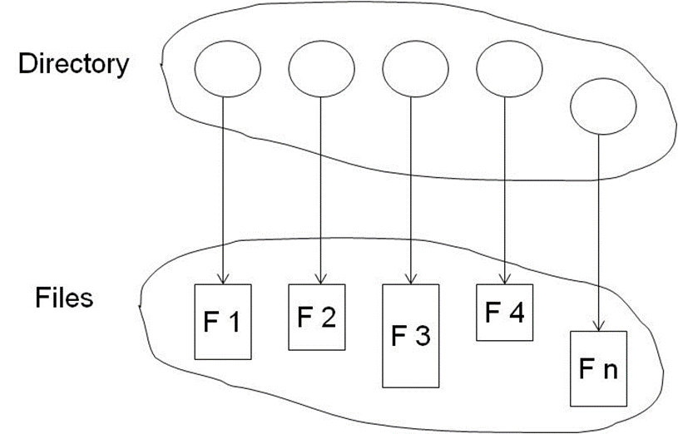
Directory structure
Directory can be viewed as a symbol table that translates file names into their file control blocks
Directory structure: A collection of nodes containing information about all files
Where are the directory structure and the files located?
Both the directory structure and the files reside on disk

Slide 8
Operations performed on directory
Search for a file: search a directory structure to find the entry for a particular file
What is a Linux command to search for files?
“find” is a very powerful command. Read its man page.
Create a file: New files need to be created and added to the directory
Delete a file: remove a file from the directory
List a directory: list the files in a directory and the contents of the directory entry for each file in the list.
Rename a file: rename a file within the directory
Traverse the file system: access every directory and every file within a directory structure

Slide 9
Directory organization
The directory is organized logically to obtain
Efficiency – locating a file quickly
Naming – convenient to users
Two users can have same name for different files
The same file can have several different names
Grouping – logical grouping of files by properties, (e.g., all Java programs, all games, …)

Slide 10
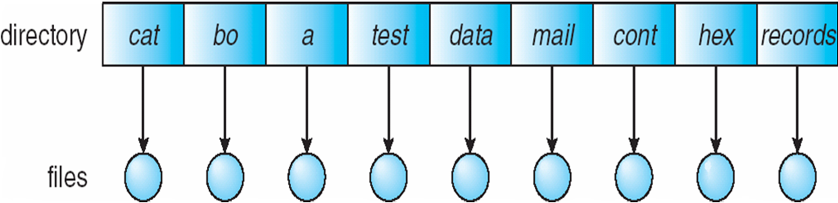
Single-level directory
A single directory for all users
What are potential problems with a single-level directory?
Naming problem
Two users cannot have the same file name for different file contents
Grouping problem
There is no way for logical grouping of the files

Slide 11
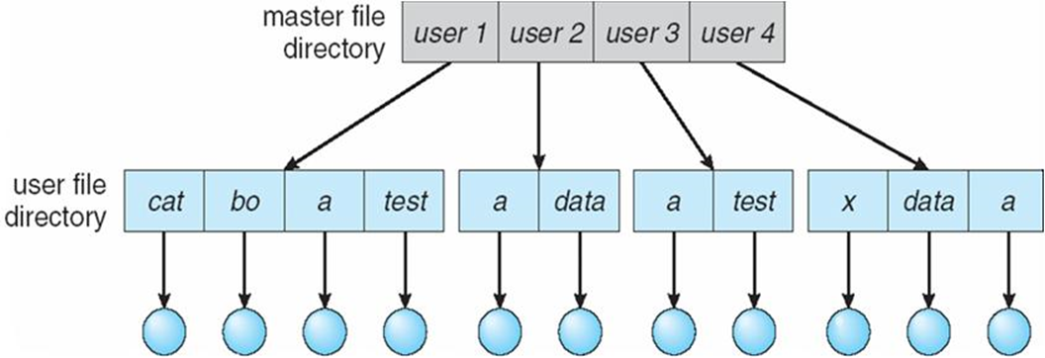
Two-level directory
Separate directory for each user
Can have the same file name for different user
Efficient searching
No grouping capability

Slide 12
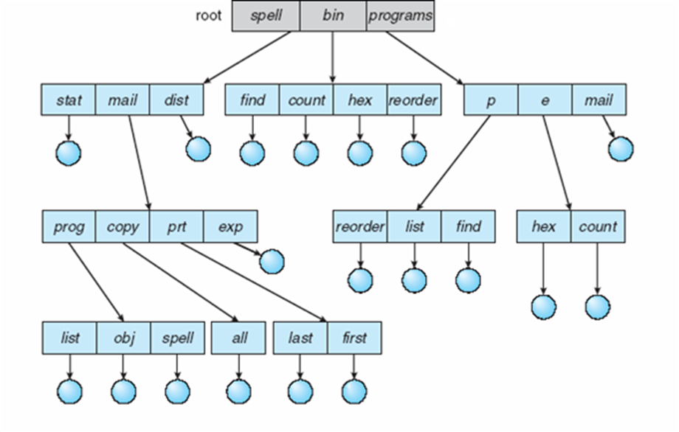
Tree-structured directories
Efficient searching
Grouping capability

Slide 13
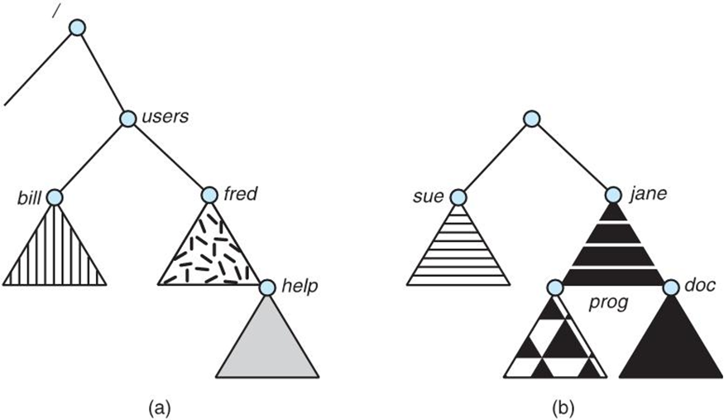
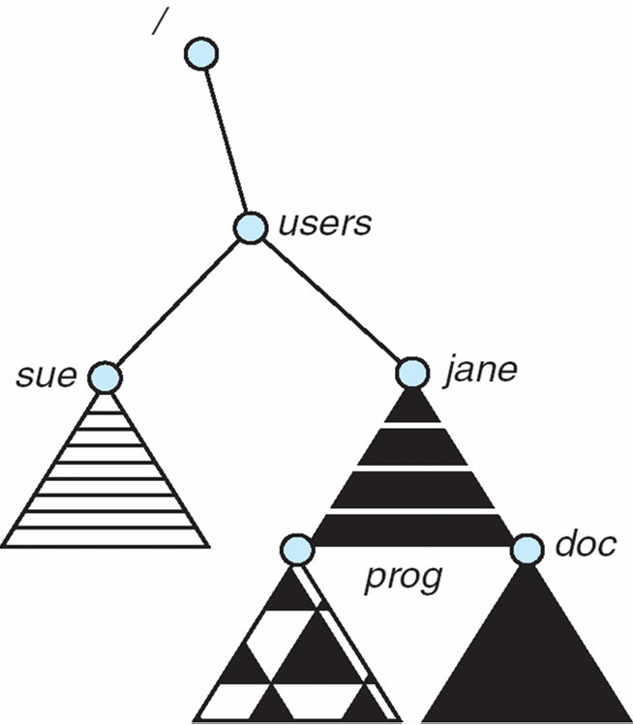
File system mounting
A file system must be mounted before it can be accessed
An unmounted file system is mounted at a mount point
file system structure
unmounted file system
after mounting

Slide 14
File sharing
Sharing of files on multi-user systems is desirable
Sharing may be done through a protection scheme
On distributed systems, files may be shared across a network
Network File System (NFS) is a common distributed file-sharing method
If multi-user system
User IDs identify users, allowing permissions and protections to be per-user
Group IDs allow users to be in groups, permitting group access rights
Owner of a file or directory
Group of a file or directory

Slide 15
Protection
File owner/creator should be able to control:
what can be done
by whom
Types of access
Read
Write
Execute
Append
Delete
List

Slide 16
Access lists and groups
Mode of access: read, write, execute
Three classes of users on Linux
a) owner access | 7 | ⇒ | RWX 111
b) group access | 6 | ⇒ | RWX 110
c) public access | 1 | ⇒ | RWX 001

Slide 17
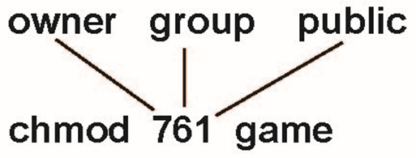
Access lists and groups
Ask manager to create a group (unique name), say “G”, and add some users to the group.
For a particular file (say “game”) or subdirectory, define an appropriate access.
Attach a group to a file
chgrp | G | game

Slide 18
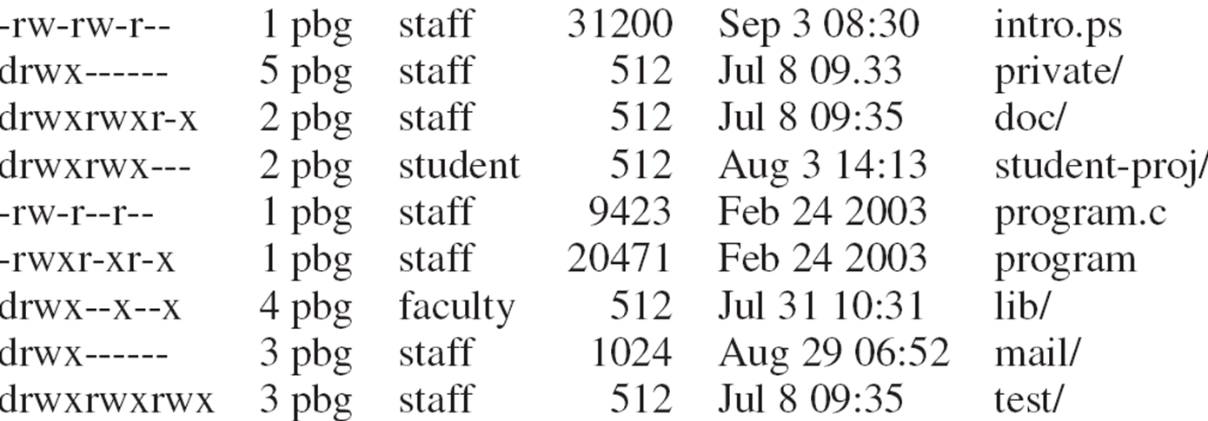
A sample UNIX directory listing

Slide 19
Levels of File Operations

Slide 20
Hardware-level file operations
Hardware-level file operations include
fdisk: divide a hard disk, USB drive, etc. into partitions
mkfs: format disk partitions to make them ready for ﬁle systems
fsck: check and repair ﬁle system
Will go through the file system and check for consistency, and fix inconsistency problems
defragmentation: compact ﬁles in a ﬁle system
These operations are often used for creating and maintaining file systems
Important tools for system administration
Less important for average users

Slide 21
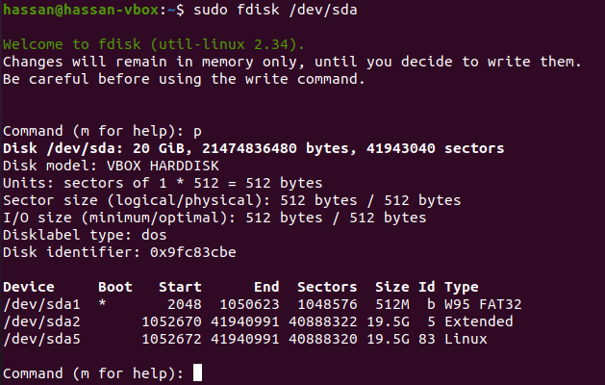
Hardware-level file operations (cont.)
fdisk command (as an example):
Used to show and/or manipulate partition table (e.g., creating partitions)

Slide 22
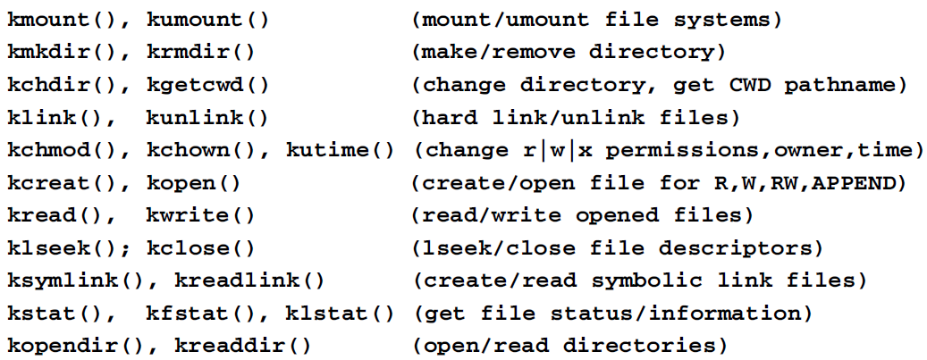
File system functions in OS kernel
This refers to functions that execute in kernel mode
These functions provide support for file operations
Examples (see below):
The notion of ‘file system’ does not apply to embedded systems but file systems are essential in general operating systems.

Slide 23
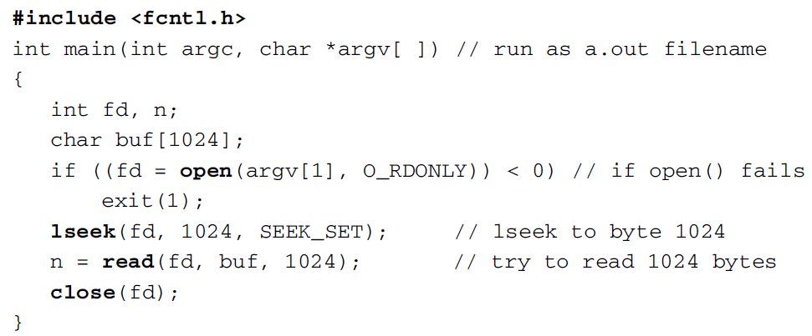
System calls for file operations
Recall that user mode programs use system calls to access kernel functions
The only way for user programs to execute kernel functions is through system calls.
For example, the following program reads second 1024 bytes of a ﬁle

Slide 24
Explanation of the example
Functions open(), read(), lseek() and close() are C library functions.
These functions issue a system call causing process to enter kernel mode to execute kernel functions such as kopen(), kread(), etc.
Why transferring data in blocks is a wise decision as we did in this example?
Switch between user mode and kernel mode is time consuming.
Data transfer between kernel and user spaces is therefore expensive.
Although it is permissible to issue a read(fd, buf, 1) system call to read only one byte of data, it is not wise to do so due to the huge overhead.
Therefore, every time we enter kernel, we should do as much as we can to make the journey worthwhile.
In case of read/write ﬁles, the best way is to match what kernel does.
Kernel reads/writes ﬁles by block size that ranges from 1KB to 8KB
In Linux, default block size is 4KB for hard disks

Slide 25
Library I/O functions
Why library I/O functions? What is the need?
System calls allow user program to read/write chunks of data
However, data is only a sequence of bytes from a system calls perspective
On the other hand, user programs need to read/write specific data types (e.g., chars, lines, structures).
Therefore, library functions provide a means for user programs to read/write data of various types, lengths, and formats.
What happens without library I/O functions?
With only system calls, a user mode program must do these operations from/to a buffer area by itself
Inconvenient and burdensome for programmers
C library provides standard I/O functions for convenience and run-time efﬁciency

Slide 26
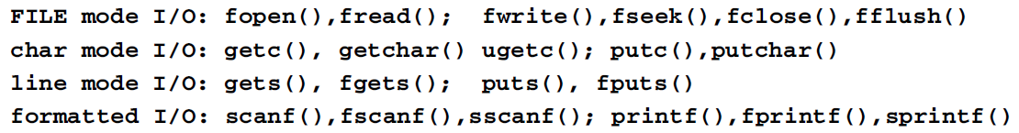
Library I/O functions
Standard library I/O functions include these categories:
Note
sscanf() and sprintf() read/write memory locations
All other library I/O functions ultimately issue system calls for actual data transfer through system kernel
read formatted data from string
write formatted data to string

Slide 27
User commands
Users use commands to perform ﬁle operations
Examples of user commands are
mkdir rmdir cd pwd
ls link unlink rm
cat cp mv chmod
User commands are usually executable programs
Commands may call library I/O functions
The library I/O functions then issue system calls to invoke kernel functions
The processing sequence of a user command is
or

Slide 28
Sh scripts
Shell scripts provide highest level of I/O operations
Commands are usually entered manually
What if we have several/many commands to execute?
We can write a shell script to accommodate all the commands we need to execute
sh scripts are programs written in shell programming
Commands in a sh script are interpreted by sh
sh language include all valid commands
sh also supports variables and control statements, such as if, do, for, while, case, etc.
Other script languages include Perl and Tcl

